Slide 1
PROGRESS REPORT ON ML-assisted Signal Quality Assessment of PPG Signals With Related Hardware Implementation
Presented By:
Archana Kumari
Univ. Roll no.– T91/ECE/204058
Univ Registration no.– D01-1211-0077-20
Shwashwat Das
Univ Roll no.– T91/ECE/204074
Univ Registration no.– D01-1111-0206-20
B.Tech in Electronics and Communication Engineering
Supervisor:
Dr. SUMITRA MUKHOPADHYAY
(Department of Radio Physics and Electronics, University of Calcutta)

Slide 2
Dataset prepared from different sources
Dataset names | No. of Subjects | Time length | Segments per patient |  | Total no. of 10s windows from each dataset (overlapping windowing 10s / 6s)
MIMIC 3 (125Hz) | 17 | 10min | 99 | = |  | = | 1683
BIDMC (125Hz) | 15 | 8min | 79 | = |  | = | 1185
DaLiA (64Hz) | 15 | 10min | 99 | = |  | = | 1485
MIMIC_PERForm AF (125Hz) | 19 | 10min | 99 | = |  | = | 1782
CSL (125Hz) | 2 | 10min | 99 | = |  | = | 198
 | 68 |  | 6432 |  | Test -3216, Train – 3216 | Test -3144, Train - 3144 |  |  | G/Avg/B = 2144

Slide 3
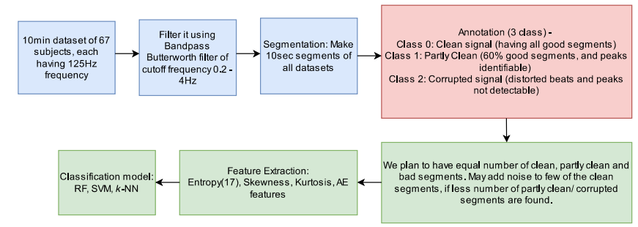
Next steps:
Done
Currently working on
Future tasks

Slide 4
Doubts
Should we normalize the data?
Do we need to monitor SNR?
After annotation what should be distribution of classes?
How to store patient ID alongwith annotation?

Slide 5
References
GitHub repo: https://github.com/archana-9430/Final-year-project-Biomedical-Signal-Analysis/

